Slide 1
Applied ML Workflow
Part I: Principles + Data Preparation

Slide 2
From ML coursework
[1] x, y = pd.read_csv(“kaggle.csv”)
[2] model = scikit(x, y)
[3] pred = model.predict(x_test)
pred.to_csv(“winning_entry.csv”)

Slide 3
From ML coursework
[1] x, y = pd.read_csv(“kaggle.csv”)
[2] x_new = remove_weird_columns(x)
[3] model = scikit(x_new, y)
[4] pred = model.predict(x_test)
pred.to_csv(“winning_entry.csv”)

Slide 4
From ML coursework
[1] x, y = pd.read_csv(“kaggle.csv”)
[2] x_new = remove_weird_columns(x)
[3] model_way_better = scikit_gbm(x_new, y)
[4] pred = model.predict(x_test)
pred.to_csv(“winning_entry.csv”)

Slide 5
Not a Great Workflow
[1] x, y = pd.read_csv(“kaggle.csv”)
...
[..??] pred = model.predict(x_test)
pred.to_csv(“winning_entry.csv”)

Slide 6
Design Principles
Iterative improvements
Reproducibility
Modularity

Slide 7
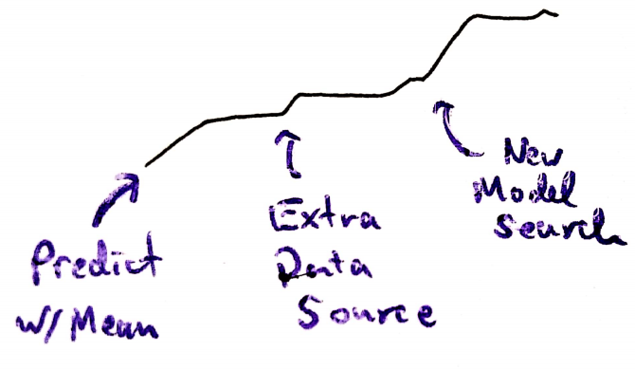
Iterative Improvements

Slide 8
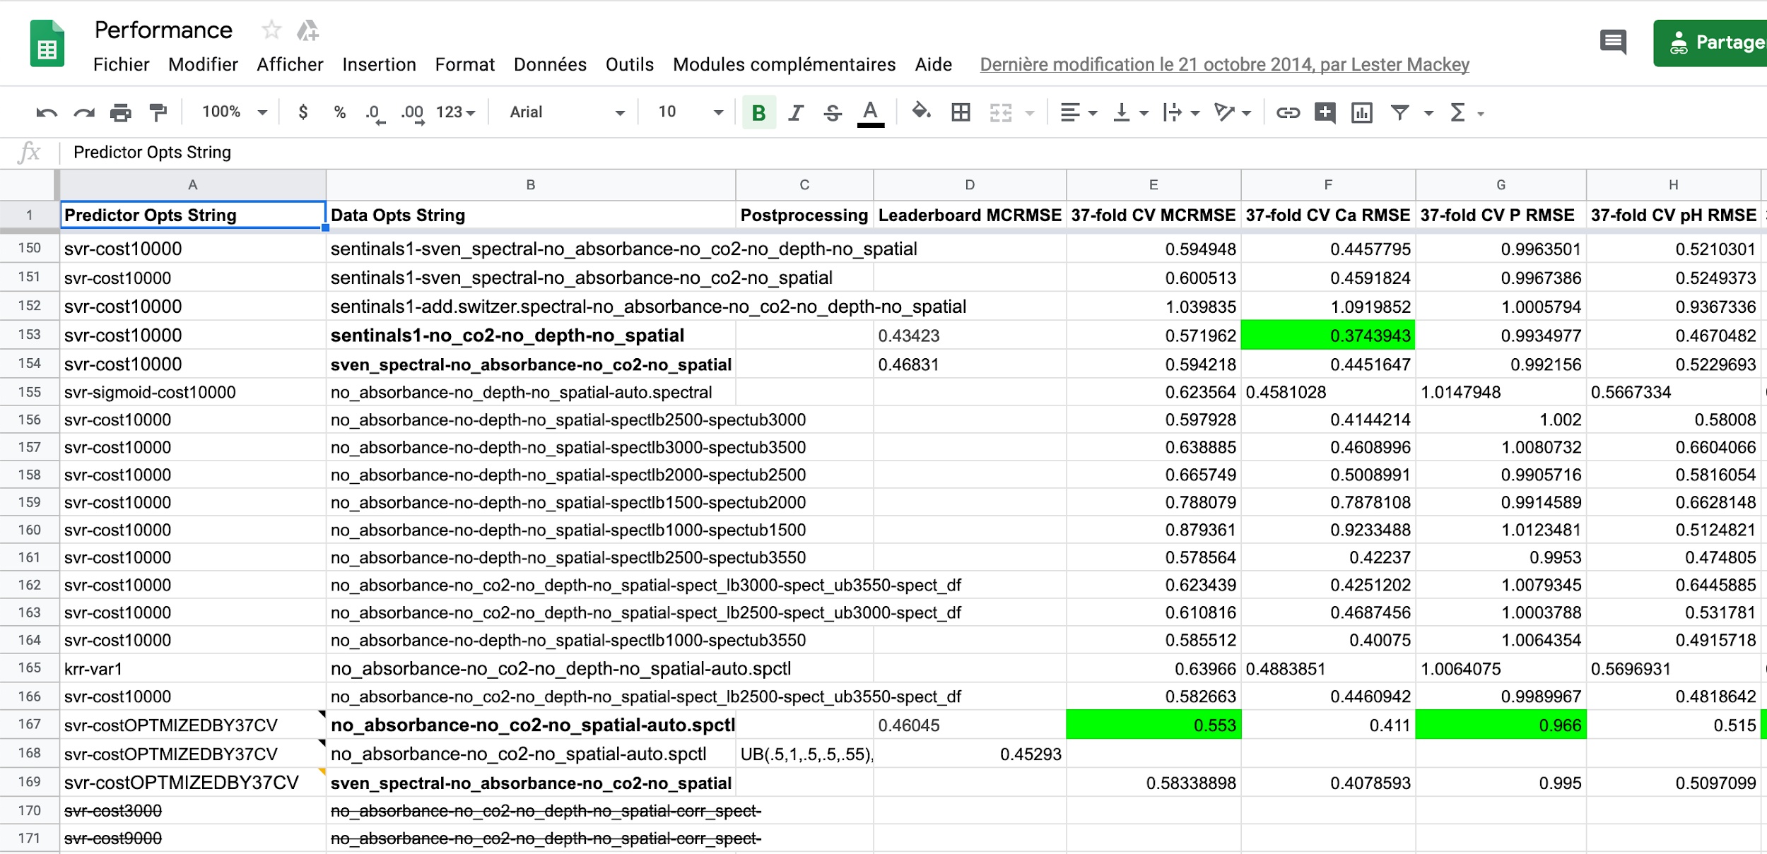
Iterative Improvements

Slide 9
Reproducibility
Cannot reproduce result → Hard to make improvements
Might as well make predictions by hand...
Ideally, something like,
$ bash pipeline.sh models_0522.json preprocess_0522.json
would work to exactly recover the predictions and models at any time.

Slide 10
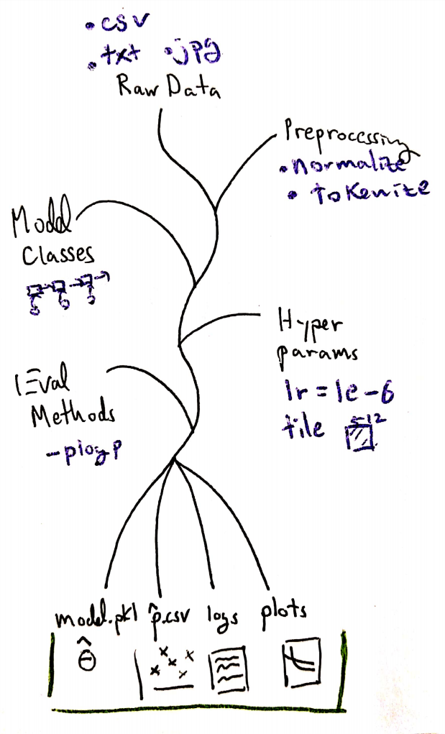
Modularity
Isolated components swapped in and out
Can reuse common intermediate outputs

Slide 11
Project Structure
- data - models - processed - raw - configs - for data or models - pipeline - eval - preprocess - train - models - class definitions | - expers - experiments with one-off models - different exploratory scripts - cluster - singularity definition - cluster sbatch script - shell scripts to launch

Slide 12
Project Structure
- data <- don’t commit! - models - processed - raw - configs (json or yaml) - for data or models - pipeline - eval - preprocess - train - models (unified interface) - class definitions | - expers - experiments with one-off models - different exploratory scripts - cluster - singularity definition - cluster sbatch script - shell scripts to launch

Slide 13
Cleaning & Data Prep.

Slide 14
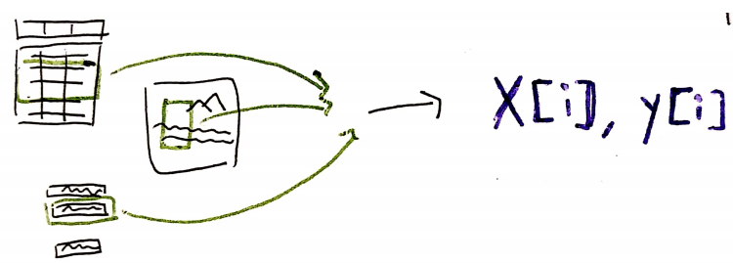
Purpose
Convert (messy) directory input into x[i], y[i] pairs
Never change the raw input!
Shared semantic units across input sources
Create intermediate datasets

Slide 15
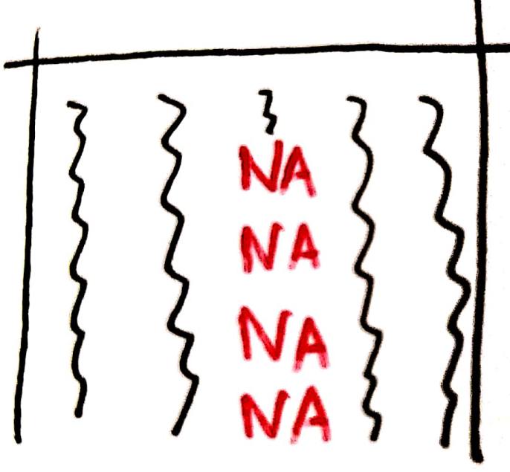
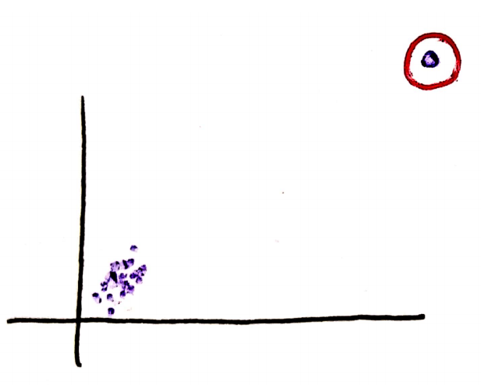
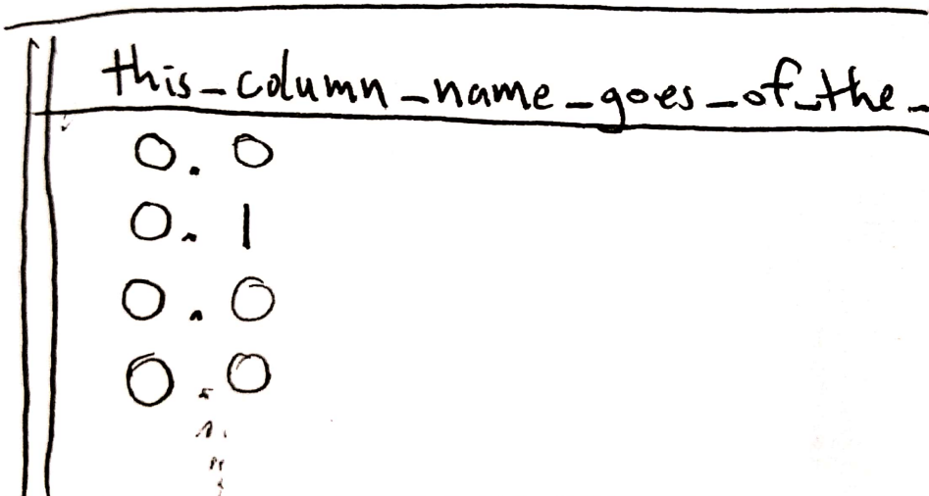
Cleaning
Coding categorical variables
  “Lumping” rare categories
Ensuring samples lie on rows (“tidying”)
Tokenizing / removing rare words
Simplifying messy names
Dealing with missing values
Removing or truncating outliers
Using shared names (“Ivory Coast” in X vs. “Cote d’Ivoire” in Y)
Converting date formats
Shared map projections
This is somewhat problem dependent...
Notes:
Story: Spike of transactions on the day the nonprofit did a data transfer….

Slide 16
Data Prep.
Defining semantic units
  City blocks vs. Households
  Transactions vs. Hours
  Sentences vs. Characters
    Padding short sentences
Joining across tables
Developing derived features
  Word embeddings
  E.g. 05/22/2019 03:02pm ->
  [2019, 5/22, “afternoon”, “Wednesday”, …]

Slide 17
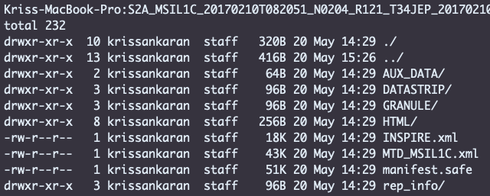
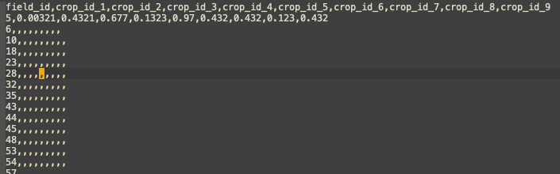
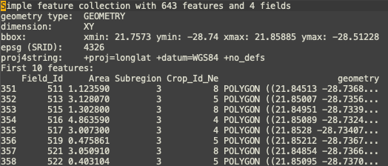
Example: Crop Detection Competition
Goal: Predict crop types from satellite imagery.
Input | Required Predictions
esoteric satellite format...
field coordinates
Probabilities for crops

Slide 18
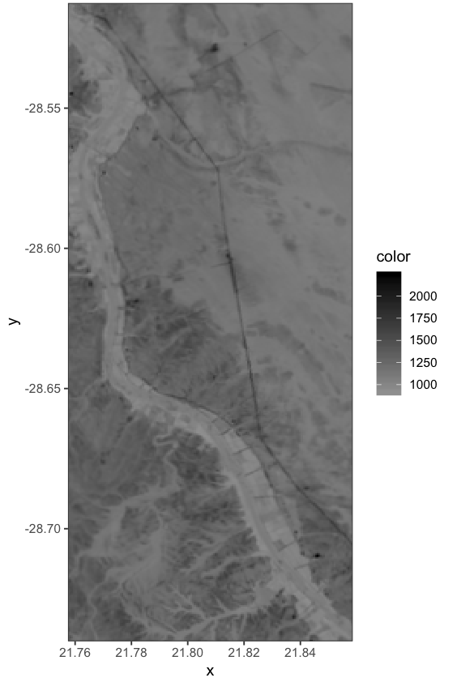
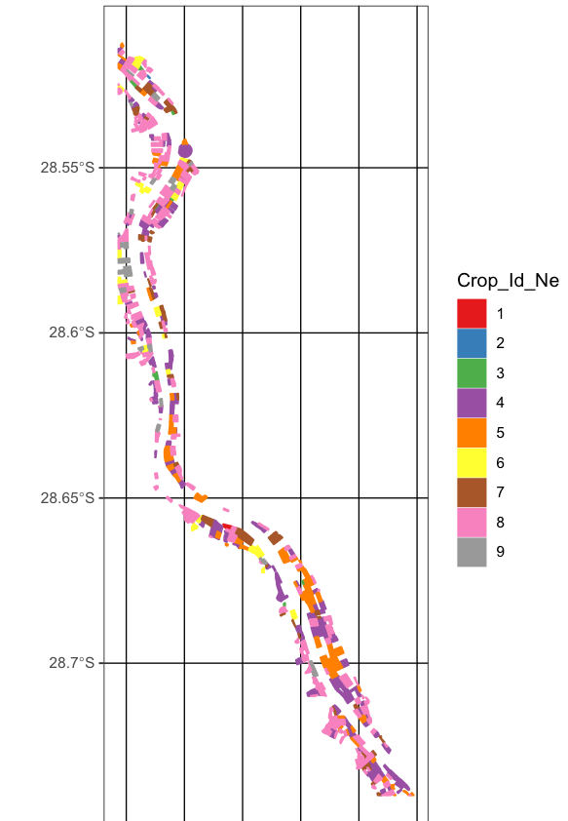
Example: Crop Detection Competition
Goal: Predict crop types from satellite imagery.
Input (subset) | Required Predictions
Probabilities for crops

Slide 19
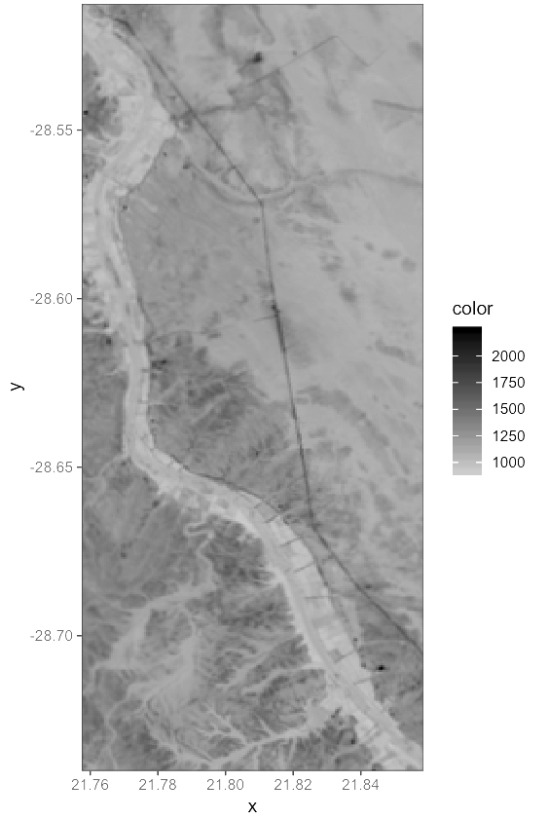
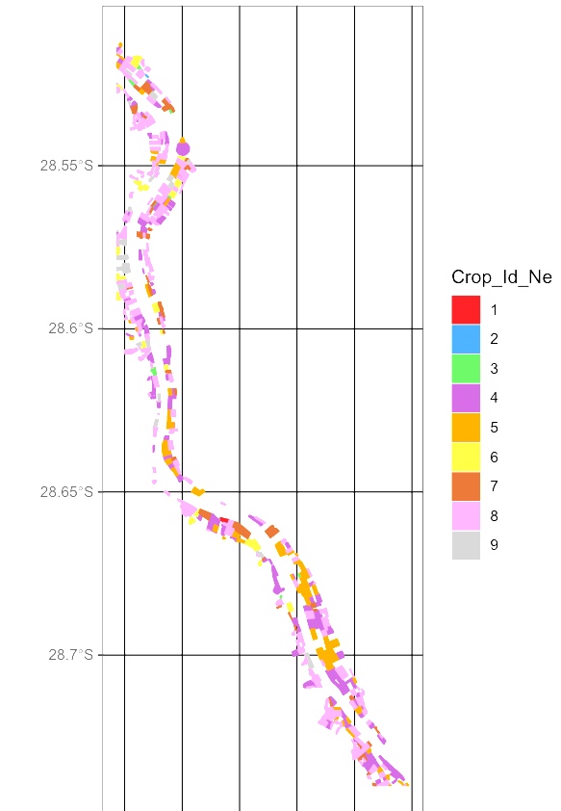
Example: Crop Detection Competition
Goal: Predict crop types from satellite imagery.
Input (subset) | Required Predictions
Cleaning:
Reproject to shared coordinates
Convert to geotiff
Probably things we haven’t thought off..
Probabilities for crops

Slide 20

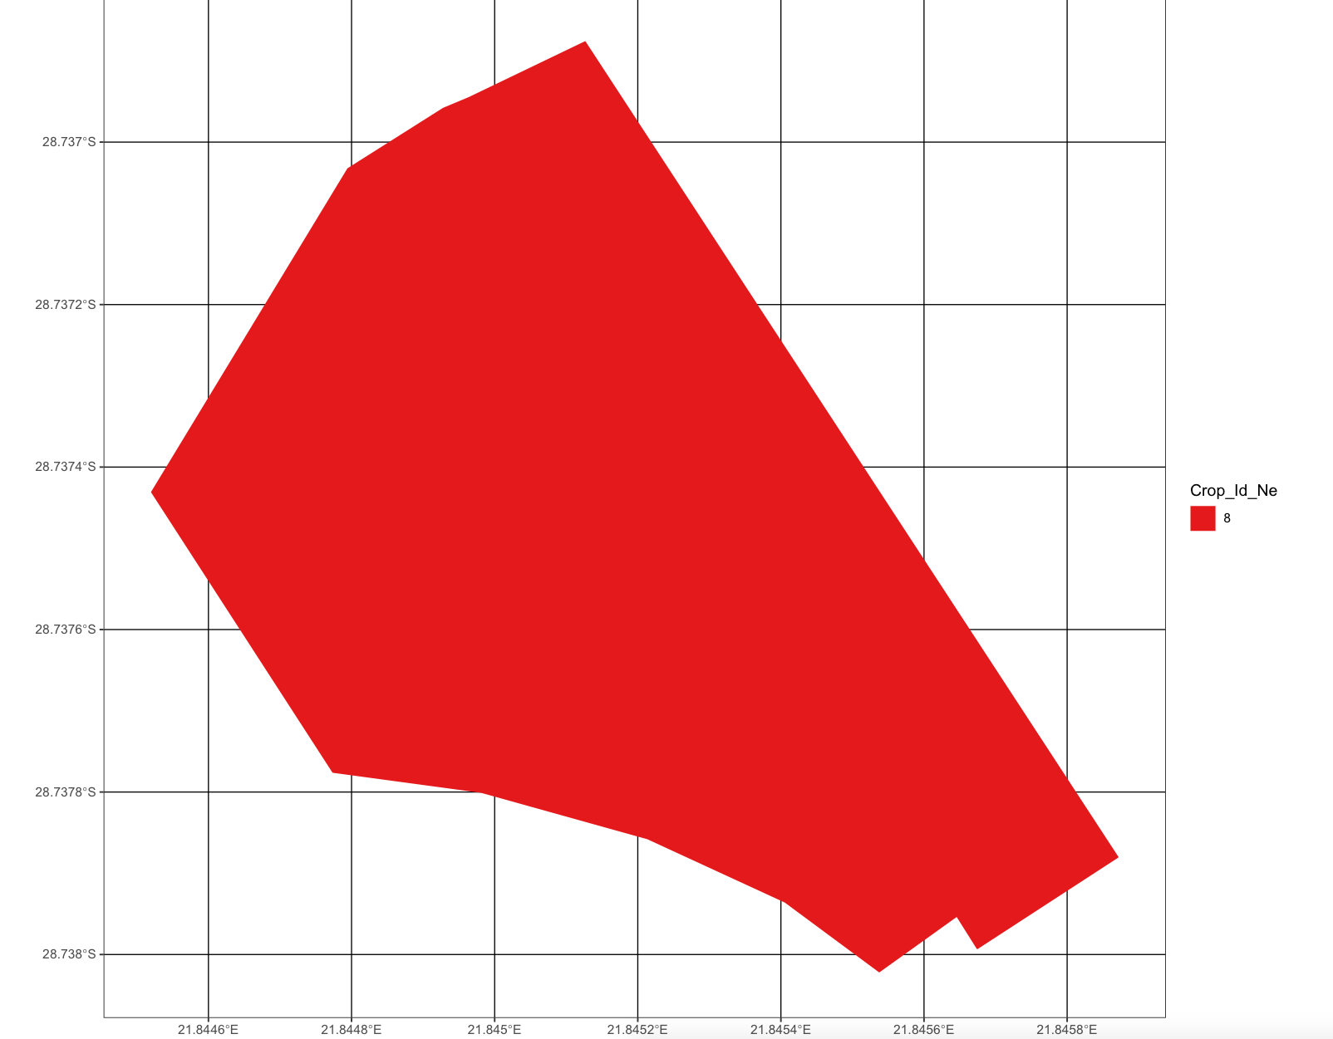
Example: Crop Detection Competition
Goal: Predict crop types from satellite imagery.
Input (semantic = single farm field) | Required Predictions
Context
x[i]
Center lat/long
Neighboring field crops
Area
Date
Shape?
y[i] = [0 0 0 … 1 0]
Probabilities for crops

Slide 21
For the Future
Cluster Q&A
Model definition conventions
Example workflows for text, maps
… anything else?

